Slide 1

React 2

Slide 2
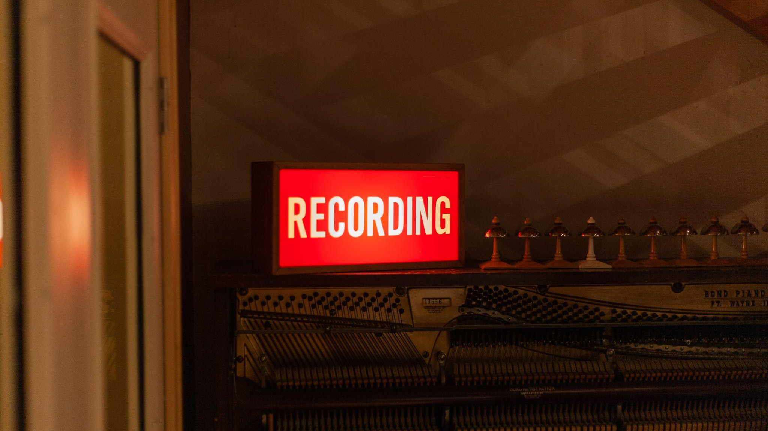

Slide 3

React8-Hooks

Slide 4
React8 - Hooks
Basic Hooks:
useState
useEffect
useContext
Ref: https://reactjs.org/docs/hooks-reference.html

Slide 5
UseContext
AppComponent
firstName
Component-1
Component-2
Component-3
firstName
firstName
SubComponent-3
SubComponent-1
SubComponent-2
firstName
firstName
SubComponent-3A
firstName

Slide 6
React9 – Todo List

Slide 7
React10-Asynchronous Programming in React
Creating custom hook to fetch data from API
Axios vs Fetch
Hiding your API key
Gracefully handling errors

Slide 8
React11- React Router
Installation
Basic Routing
Redirection
Params

Slide 9
React Router
BrowserRouter: uses the HTML5 history API to keep your UI in sync with the URL.
Routes and Route : Primary way to render something in React Router based on current location. Route is like if statement, whenever location changes Routes looks thru all of its children Route to find best match URL and render that component.
Link: A <Link> is an element that lets the user navigate to another page by clicking or tapping on it

Slide 10
Exercise-3
Create a simple react counter
There should be two buttons, one to increment other to decrement count value.
Count should start with zero
If count value is less than -3 or greater than +3 reset count value 0

Slide 11
Exercise-4
Create a react app
Create a Jumbotron
Expected Output: https://getbootstrap.com/docs/4.0/components/jumbotron/
Use appropriate CSS

Slide 12
React12-Shopping Cart Design
Scaffolding the application
Global State Management
Design Functionality to Add items to cart
Design functionality to remove items
Calculate final price

Slide 13
Global State Management
React Application
Store
Holds application state
Exposes methods so that we can access and update state
Action
Helps to interact with store.
Carry info from app to store
Plain JS objects
Have type property that indicates type of action being performed
Optionally have payload which gives additional information about what happened.
Reducers
Specify how the app’s state will change in response to actions sent to the store

Slide 14
Homework-2 Clone Vanilla JS Pages into ReactJS
Accordion Design: https://vanilla-js-basic-project-7-questions.netlify.app/

Slide 15
Homework-3 Clone Vanilla JS Pages into ReactJS
Review Page / Testimonial Page : https://vanilla-js-basic-project-3-reviews.netlify.app/

Slide 16
Homework-4 Clone Vanilla JS Pages into ReactJS
Recipe App : https://vanilla-js-basic-project-8-menu.netlify.app/

Slide 17


Slide 18

Questions?
JavaScript 1

